Slide 1
Inhaled ICO-hu104
for SARS-CoV-2
Study article presentation
Broadly neutralizing humanized antibody with conserved Spike epitope binding and inhalation-based protection in non-human primates

Slide 2
Core message
ICO-hu104 combines variant breadth with lung-focused delivery.
Nebulization preserved antibody function, achieved high lower-airway exposure, and reduced SARS-CoV-2 replication after therapeutic dosing in macaques.
Source: Hermet et al., PLOS Pathogens 2023; doi:10.1371/journal.ppat.1011532

Slide 3
Why this study was needed
Variant escape
Early monoclonal antibodies lost activity as Spike accumulated mutations.
Therapeutic gap
Vaccines reduced disease burden, but immunocompromised and high-risk patients still need antiviral options.
Delivery gap
Systemic IV dosing is cumbersome and may require high plasma concentrations to reach airway mucosa.
Study objective
Find a broadly neutralizing antibody and test whether inhalation can place active mAb where respiratory infection starts.
Source: Hermet et al., PLOS Pathogens 2023; doi:10.1371/journal.ppat.1011532

Slide 4
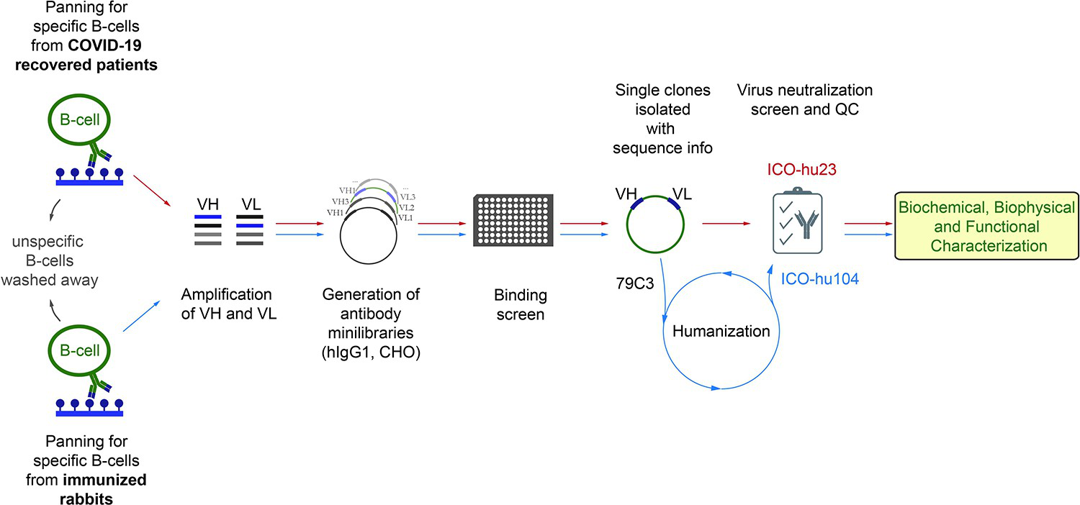
Discovery workflow
HybriFree screening reconstructed antigen-specific antibody libraries from B cells, then selected neutralizing clones for characterization and humanization.
Figure adapted from article Fig. 1.
Source: Hermet et al., PLOS Pathogens 2023; doi:10.1371/journal.ppat.1011532

Slide 5
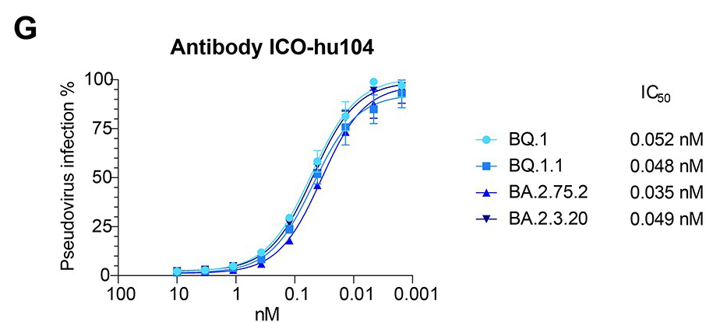
Variant breadth
Pseudovirus neutralization stayed sub-nanomolar across major tested variants.
Variant | ICO-hu104 IC50
Wuhan | 0.038 nM
Alpha B.1.1.7 | 0.033 nM
Beta B.1.351 | 0.052 nM
Delta B.1.617.2 | 0.053 nM
Omicron B.1.1.529 | 0.313 nM
Omicron BA.2 | 0.108 nM
Figure adapted from article Fig. 2G.
Source: Hermet et al., PLOS Pathogens 2023; doi:10.1371/journal.ppat.1011532

Slide 6
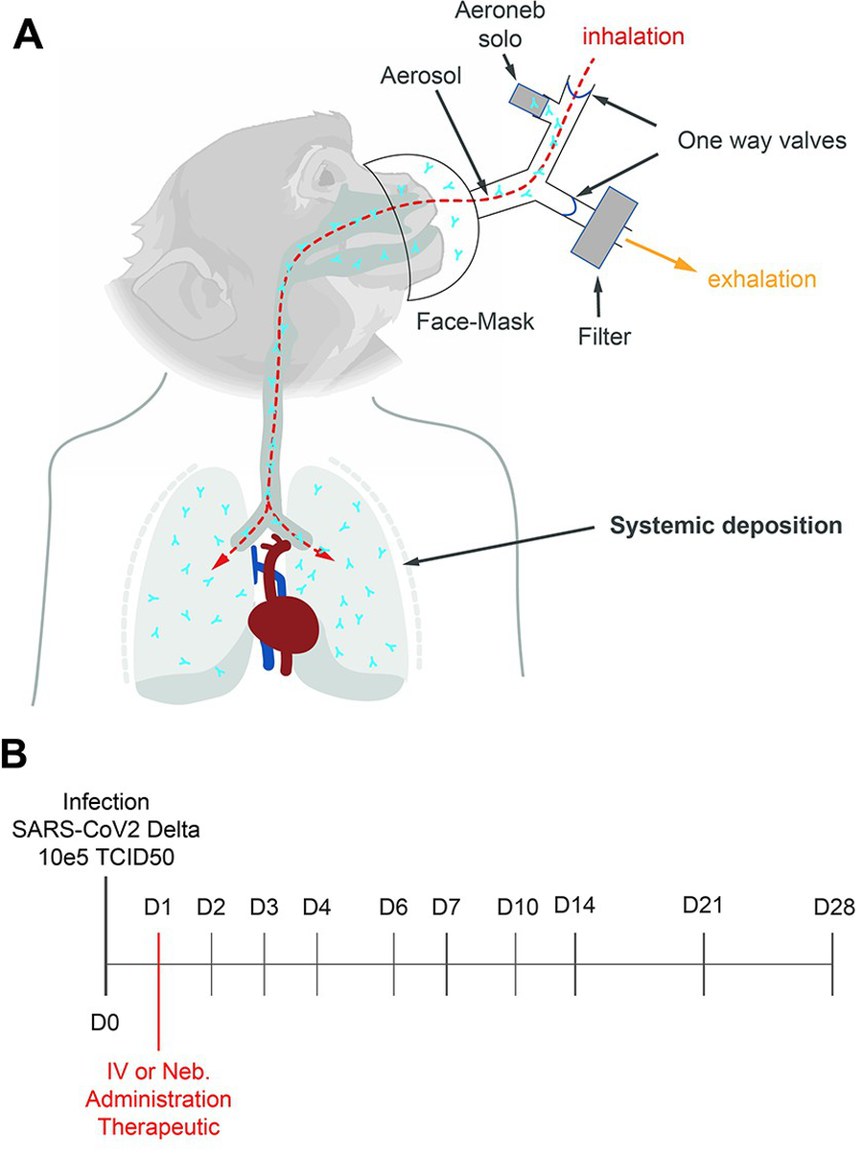
Non-human primate challenge design
Cynomolgus macaques challenged with SARS-CoV-2 Delta by intranasal and intratracheal routes.
Therapeutic dosing occurred 24 h after challenge.
ICO-hu104 was delivered as 25 mg/kg IV or by vibrating-mesh nebulization.
Controls included concurrent mock-nebulized animals and historical controls challenged under similar conditions.
Figure adapted from article Fig. 3A-B.
Source: Hermet et al., PLOS Pathogens 2023; doi:10.1371/journal.ppat.1011532

Slide 7
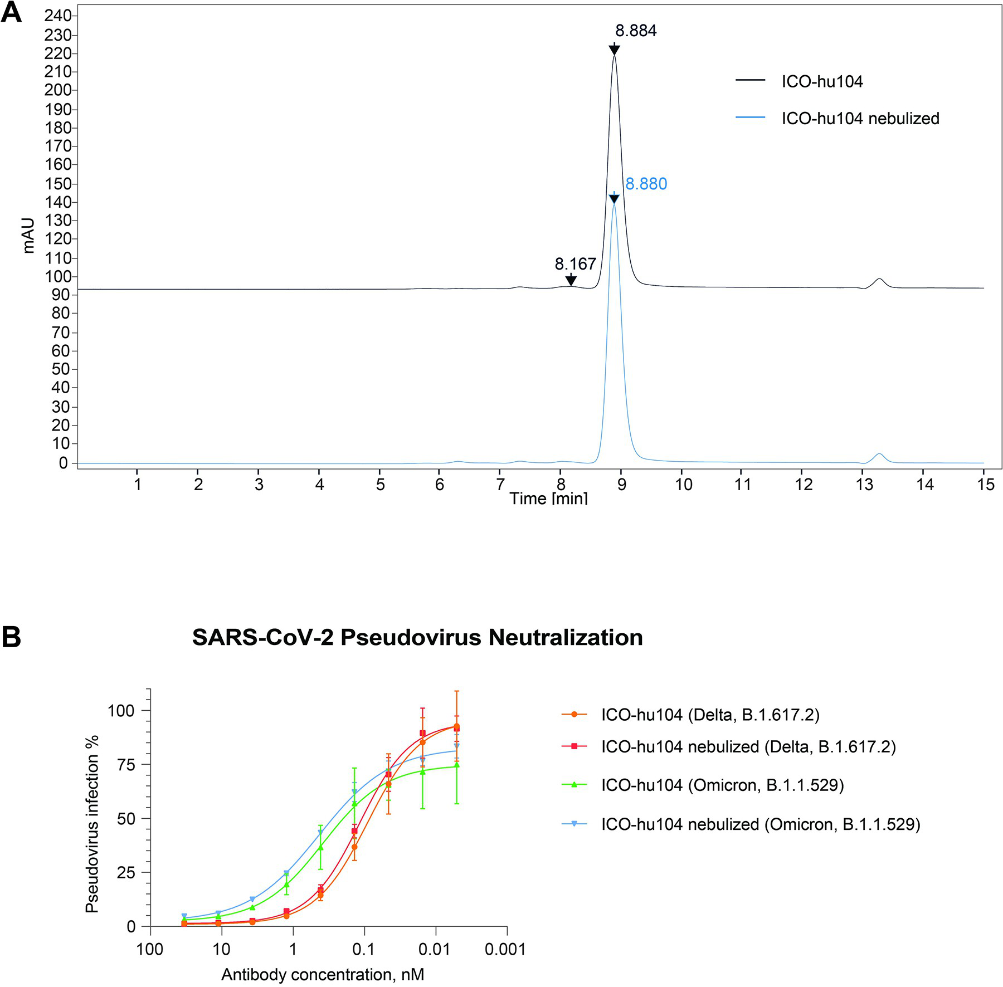
Nebulization quality
Vibrating-mesh nebulization did not detectably aggregate ICO-hu104 by SEC.
Post-nebulization samples retained pseudovirus neutralization against Delta and Omicron.
PET/CT-based extrapolation estimated a median 7.0 mg/kg deposited across the respiratory tract, including 2.4 mg/kg in the lungs.
Figure adapted from article Fig. 4.
Source: Hermet et al., PLOS Pathogens 2023; doi:10.1371/journal.ppat.1011532

Slide 8
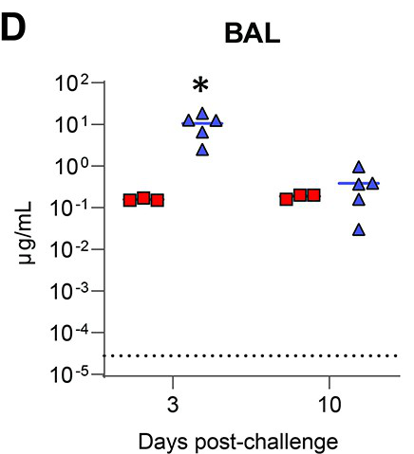
Exposure where virus replicates
Lower-airway exposure
IV dosing produced much higher serum antibody levels, but nebulization shifted exposure toward the lower respiratory tract.
BAL concentration on day 3 averaged 10.6 ug/mL after nebulization versus 0.16 ug/mL after IV dosing.
This local exposure advantage is central to the inhaled-delivery hypothesis.
Figure adapted from article Fig. 3D.
Source: Hermet et al., PLOS Pathogens 2023; doi:10.1371/journal.ppat.1011532

Slide 9
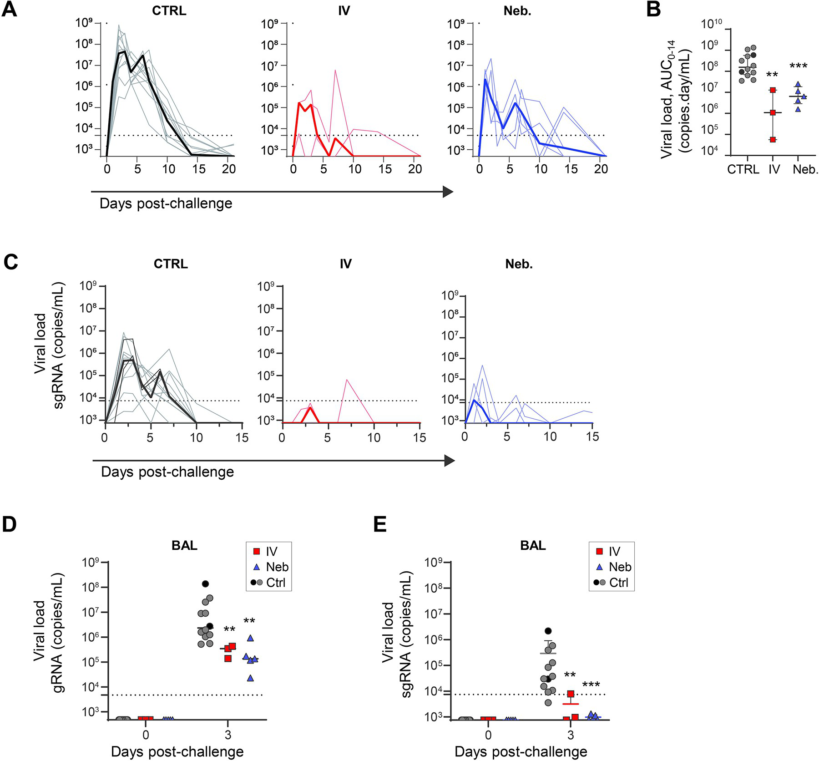
Antiviral protection in macaques
At day 2 post-challenge, nasopharyngeal gRNA fell by 2.7 log10 with IV and 2.1 log10 with nebulized treatment versus controls.
Across days 0-14, nasopharyngeal viral-load AUC was lower in both treatment groups.
BAL gRNA and sgRNA were significantly lower at day 3 in treated animals.
Figure adapted from article Fig. 5.
Source: Hermet et al., PLOS Pathogens 2023; doi:10.1371/journal.ppat.1011532

Slide 10
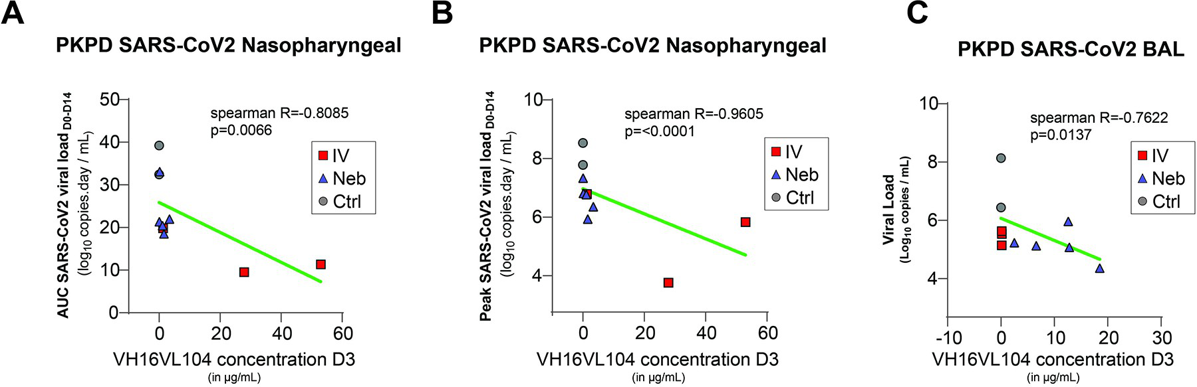
Exposure-response supports pharmacology
Higher ICO-hu104 concentrations were associated with lower viral replication in the nasopharynx and BAL.
Nasopharyngeal peak viral load: Spearman R=-0.9605, p<0.0001. BAL viral load: R=-0.7622, p=0.0137.
Figure adapted from article Fig. 6.
Source: Hermet et al., PLOS Pathogens 2023; doi:10.1371/journal.ppat.1011532

Slide 11
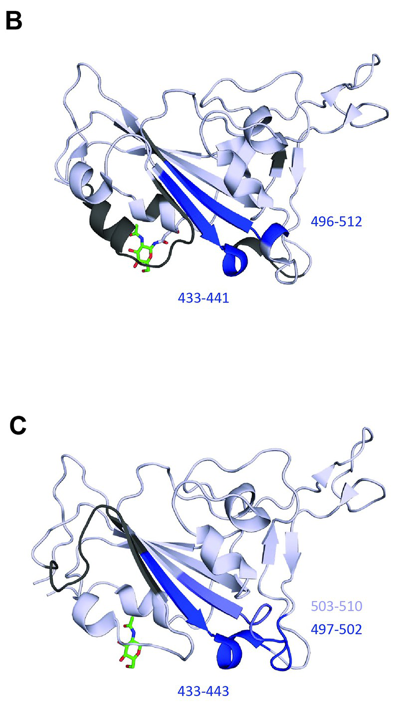
Conserved epitope explains breadth
HDX-MS mapped ICO-hu104 to exposed RBD beta-sheet regions around 433-443 and 497-510.
The key region sits away from common orthosteric sites and contains no Wuhan-to-Omicron mutations in the mapped epitope.
The earlier ICO-hu23 mapped to a mutation-rich region, explaining its loss of Omicron affinity.
Figure adapted from article Fig. 7B-C.
Source: Hermet et al., PLOS Pathogens 2023; doi:10.1371/journal.ppat.1011532

Slide 12
What it means
Advances
Pan-VoC neutralization tied to a conserved Spike/RBD epitope.
A clinically used vibrating-mesh device preserved mAb integrity and activity.
Therapeutic inhalation achieved local lung exposure and lowered viral load in a preclinical NHP model.
What remains to prove
Clinical safety, tolerability, and dose need human study.
The NHP efficacy cohort was small and used historical controls.
The authors note escape could still emerge through mutations outside the mapped epitope.
Source: Hermet et al., PLOS Pathogens 2023; doi:10.1371/journal.ppat.1011532

Slide 13
Takeaway
ICO-hu104 reframes mAb delivery for respiratory viruses: neutralize broadly, deliver locally, and reduce replication at the site of infection.
Preclinical evidence in SARS-CoV-2 Delta-challenged cynomolgus macaques.

